Slide 1
SMS Based LPG Gas Leakage Detection System Using GSM
TEAM MEMBERS:
N.SAI SRI DHARANI
N.YASHWANTH
B.BALAJI
UNDER THE GUIDANCE OF:
Mr.R.NARENDER
(Assistant Professor)

Slide 2
ABSTRACT
There are numerous answers for fireplace accidents that agencies continually endorse. Smoke detectors, hearth alarms, hearth extinguishers and sprinklers are examples of those gadgets. On reflection, those devices can also alert or prevent the unfold of fire but they do not save you hearth injuries, and that alone is a main downside already. This have a look at makes a speciality of the LPG fuel and the way to save you it from causing greater injuries. There's a want to build a system that aids people's negligence of their surroundings even as stopping the begin of conflagration. The device also implements a shut-off mechanism which acts as the first line of defence inside the prevention of the coincidence ought to there be an absence of individual inside the residence

Slide 3
Block diagram
Gas Sensor
BUZZER
GSM
Arduino UNO
POWER SUPPLY UNIT

Slide 4
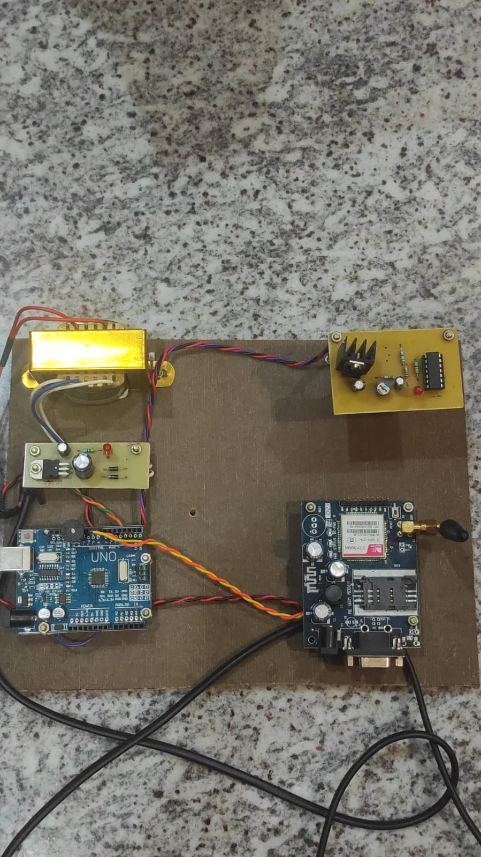
RESULT

Slide 5
ADVANTAGES
Low cost
2. Low power consumption
3. High accuracy
4. It also detects alcohol so it is used as liquor tester.
5. The sensor has excellent sensitivity combined with a quick response time.

Slide 6
DISADVANTAGES
1. No prevention of fires possible with kit.
3. It works only when at 5V power supply is given. .
5. It is a little sensitive to smoke

Slide 7
APPLICATIONS
1. No prevention of fires possible with kit.
2. Applicable only as indicator/alarming device.
3. It works only when at 5V power supply is given.
4. Its sensitivity depends on Humidity and temperature.
5. It is a little sensitive to smoke

Slide 8
THANK YOU

